Slide 1
Error Listing

Slide 2
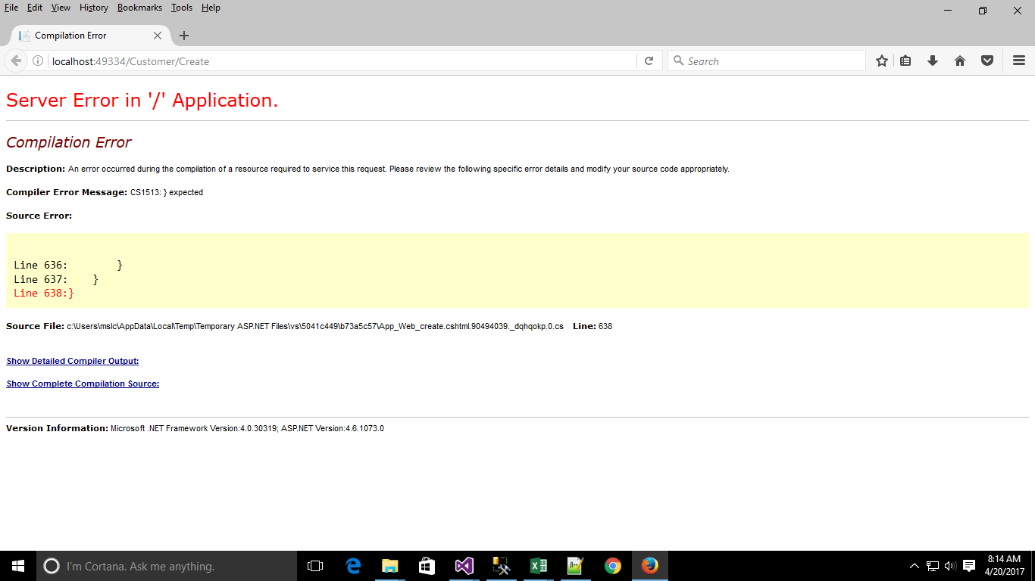
Debugged by removing Flower Bracket

Slide 3
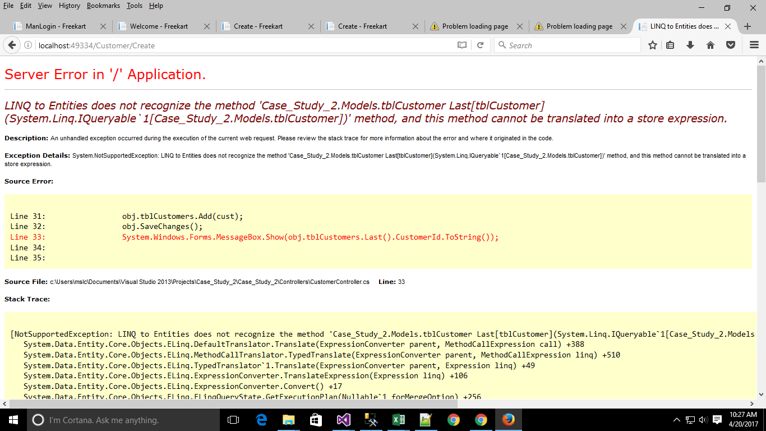
Instead of Last(), Used this: model.OrderByDescending(o => o.Id).FirstOrDefault();

Slide 4
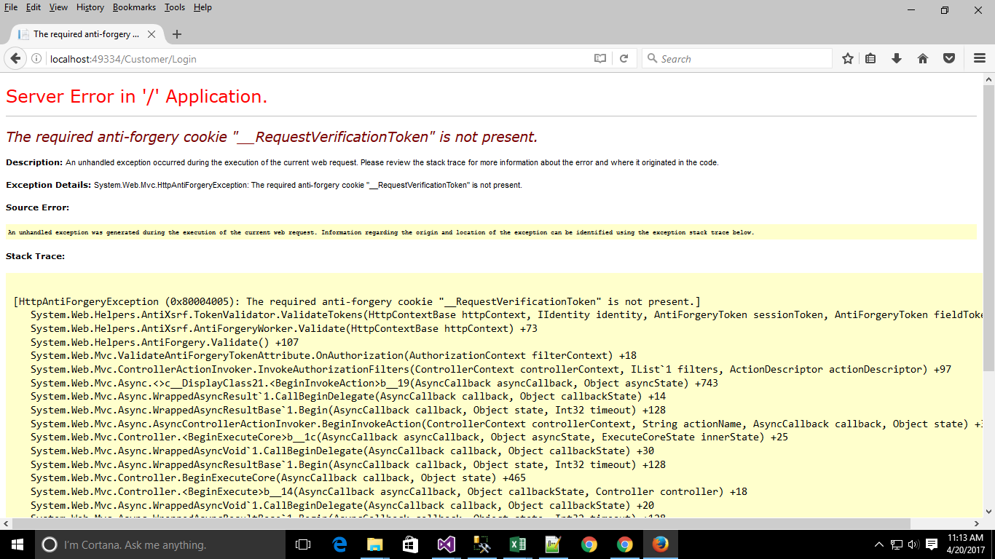
[ValidateAntiForgeryToken] Error is solved by this step add @Html.AntiForgeryToken() in the page.

Slide 5
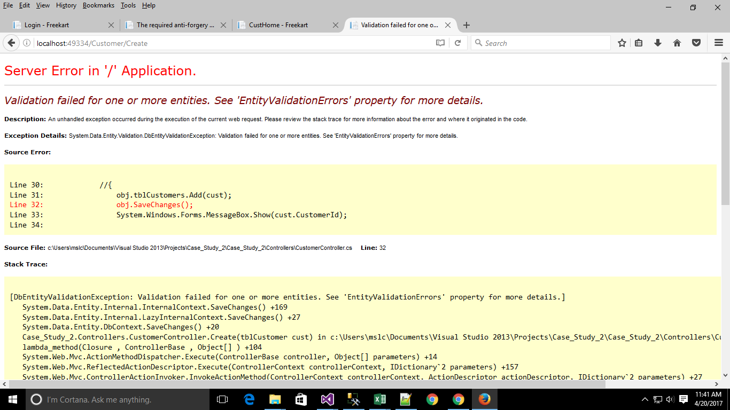
Just add a watch with the name: ((System.Data.Entity.Validation.DbEntityValidationException)$exception).EntityValidationErrors

Slide 6
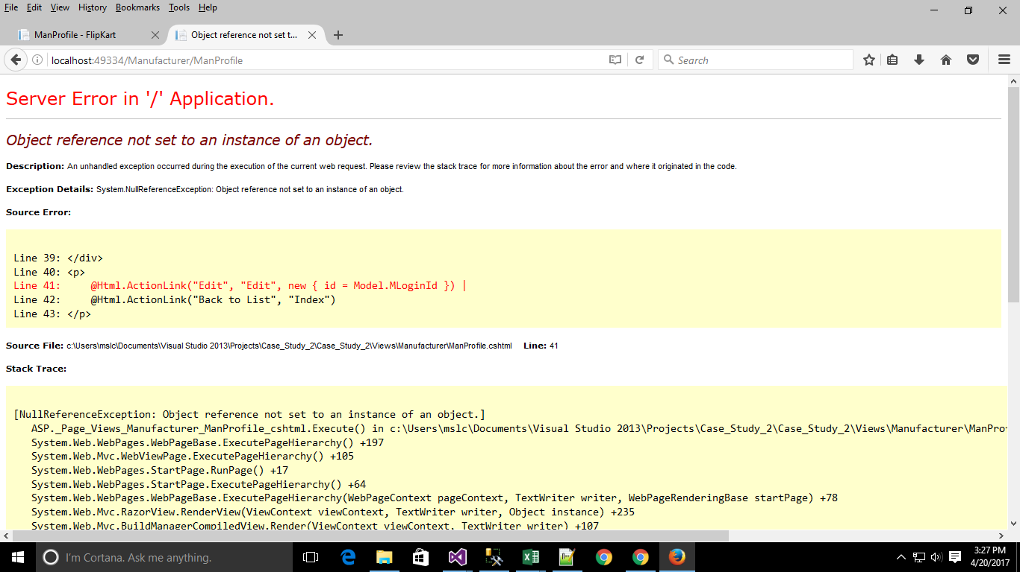
Check for the NULL Values

Slide 7
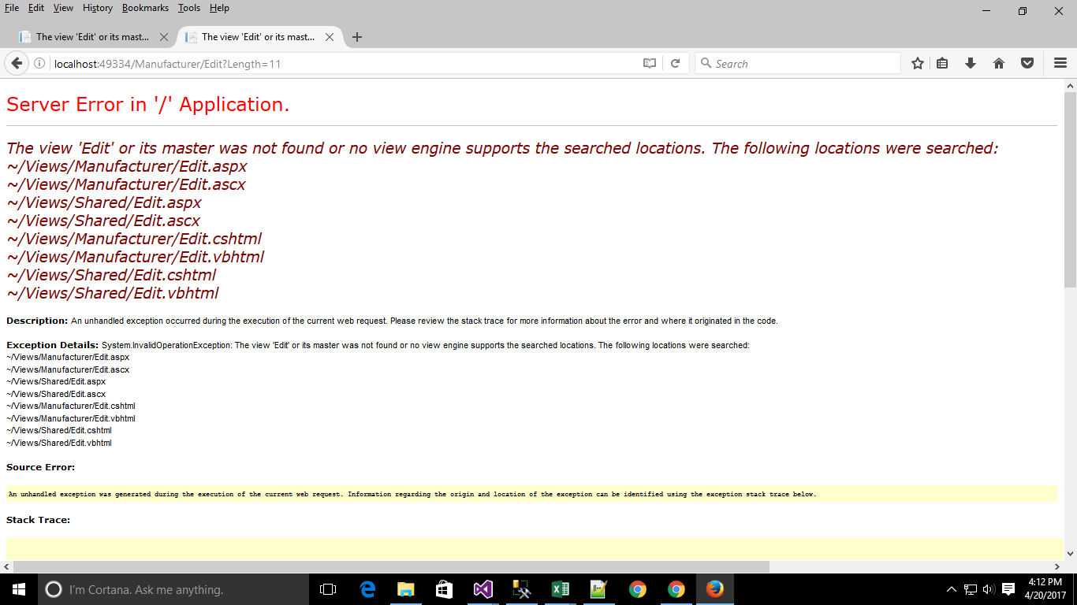
View was missing and solved by creating the View

Slide 8
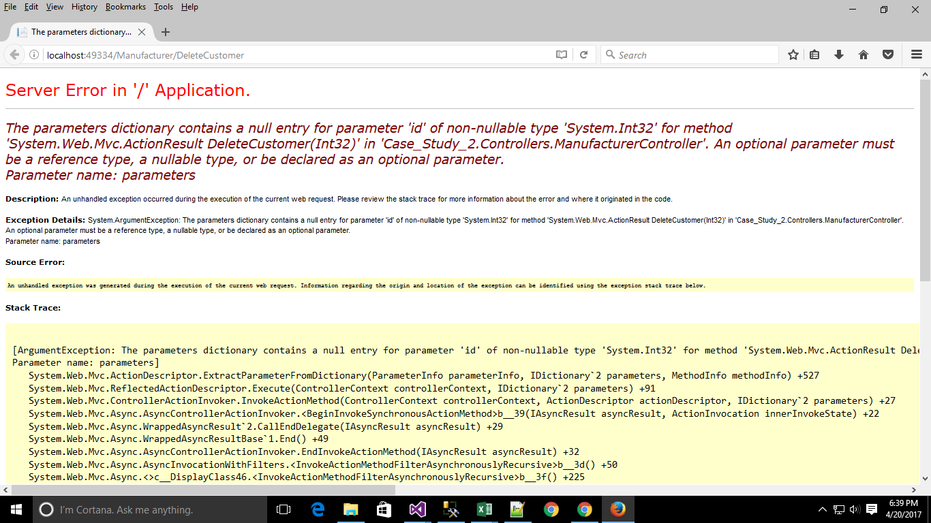
An optional parameter must be a reference type, a nullable type or be declared as an optional parameter

Slide 9
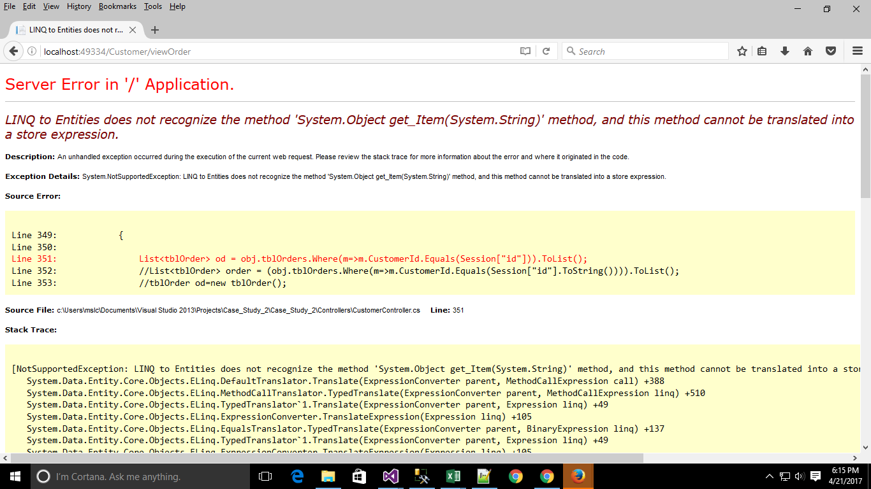
Solution : string loggedUserName = Session["LogedUsername"].ToString(); var userdetail = dc.faculties.Where(a => a.F_UserName.Equals(loggedUserName)).FirstOrDefault();

Slide 10
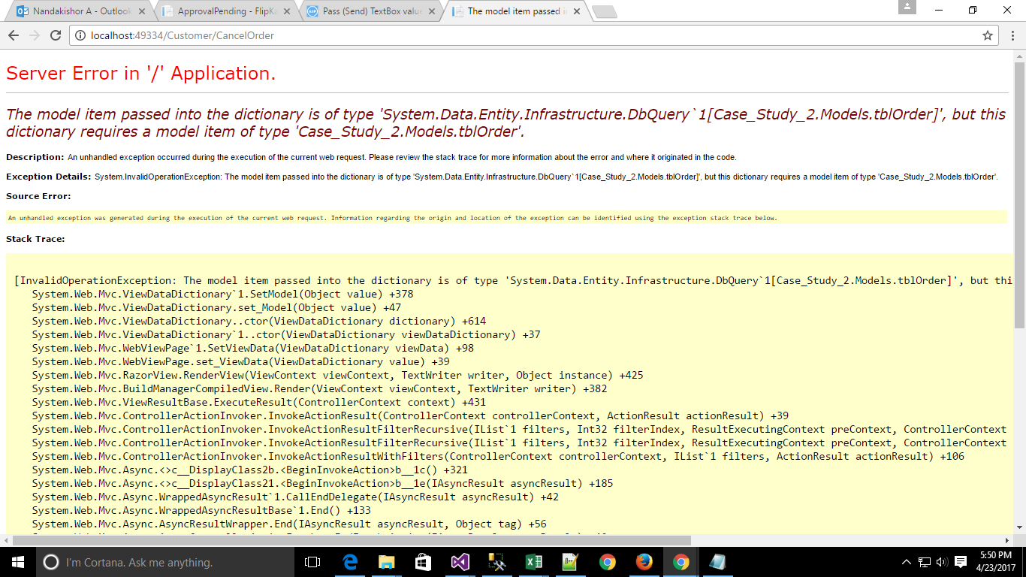
change model type of the view to IEnumerable<ResultItem>, the query will return collection of result items.

Slide 11
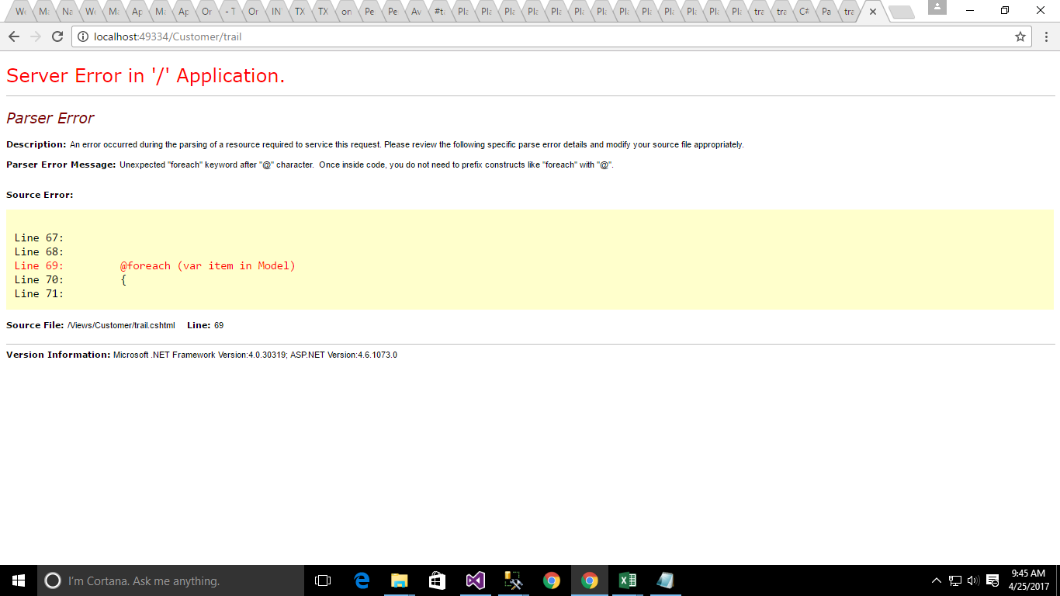
Unexpected Symbol ‘@’ before foreach

